Slide 1
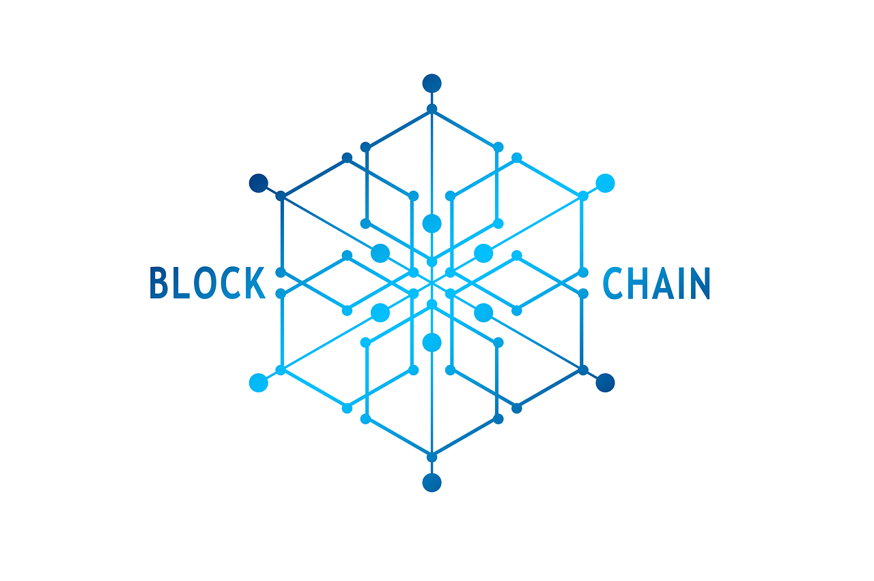


Analysis of security and privacy threats in the cloud, countermeasures adopted and how the blockchain can help

Slide 2
Index
01
Introduction on Cloud and Cloud Security
Security and Privacy threats in the Cloud
02
03
Countermeasures to Cloud Security Threats
04
Security services of the main Cloud Providers
05
Analysis of a real case study: attack to Tesla
Blockchain and Cloud Security
06

Slide 3
Introduction on Cloud and Cloud Security
01
#Introduction on Cloud and Cloud Security

Slide 4
Definition of Cloud
#Introduction on Cloud and Cloud Security
"Cloud computing is a model for enabling ubiquitous, convenient, on-demand network access to a shared pool of
configurable computing resources (e.g., networks, servers, storage, applications, and services) that can be rapidly
provisioned and released with minimal management effort or service provider interaction“
NIST

Slide 5
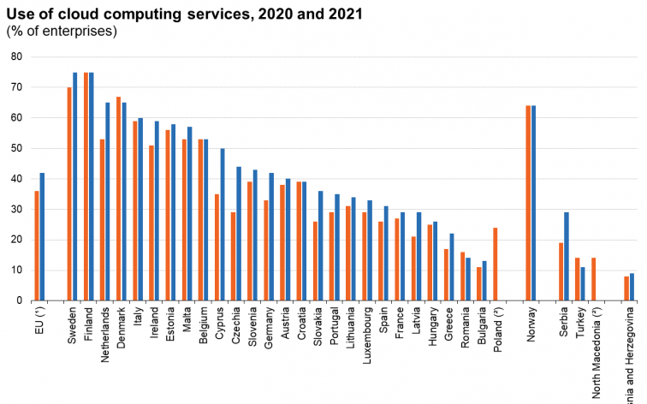
Some statistics on Cloud Usage
#Introduction on Cloud and Cloud Security

Slide 6
The main benefits of the Cloud
#Introduction on Cloud and Cloud Security
Reduced Initial Investement
Increased Scalability
Cloud consumers can scale their cloud-based IT resources to meet fluctuations and
Spikes.
The minimization of initial investments allows companies to start small and consequently increase the allocation of IT resources as needed.
On-demand usage
Increased Availability and Reliability
On-demand access to pay-as-you-go computing resources and
the ability to release them when they are no longer needed.
IT resources highly
available and reliable.

Slide 7
Security and Privacy threats in the Cloud
02
#Security and Privacy threats in the Cloud

Slide 8
Shared Responsibility for Cloud Security
#Security and Privacy threats in the Cloud
SaaS
IaaS
Software-as-a-Service
Infrastructure-as-a-Service
PaaS
Platform-as-a-Service

Slide 9

Threats Agents
#Security and Privacy threats in the Cloud
#Introduction on Cloud and Cloud Security
Anonymous Attacker
Malicious Service Agent
It intercepts and potentially corrupts the message content.
An anonymous user, consumer of cloud services with no permissions in the cloud.
Trusted Attacker
Malicious Insider
A trusted attacker shares IT resources in the same cloud environment as the cloud
Consumer.
These are usually human insiders, at the cloud service provider.

Slide 10
Outsourcing of data and computation
#Security and Privacy threats in the Cloud
#Introduction on Cloud and Cloud Security
It’s critical to have appropriate mechanisms to prevent cloud providers from using customers’ data in a way that hasn’t been agreed upon.
Example of Attacks
Traffic Eavesdropping
Malicious Intermediary
Data is passively intercepted by a malicious service agent for illegitimate
information-gathering purposes.
Messages are intercepted and altered by a
malicious service agent.

Slide 11
Denial of Service
#Security and Privacy threats in the Cloud
#Introduction on Cloud and Cloud Security
The goal of the Denial of Service (DoS) attack is to overload IT resources to the point where they cannot function properly.
Increased workload with imitation of messages
Requests designed to consume excessive memory and processing resources
Network is overloaded
with traffic
Successful DoS attacks result in server degradation and / or failure.

Slide 12

Authentication & Identity Management
#Security and Privacy threats in the Cloud
#Introduction on Cloud and Cloud Security
Problems concerning the common scenario where a user enters his user ID and password to prove his identity to the authentication server.
However, Cloud environment is susceptible to replay attack and identity theft since user passwords can easily be stolen.
Example of Attack: Insufficient Authorization
This attack occurs when access is granted to an attacker incorrectly or with too wide privileges, resulting in the attacker gaining access to IT resources that are normally protected.

Slide 13
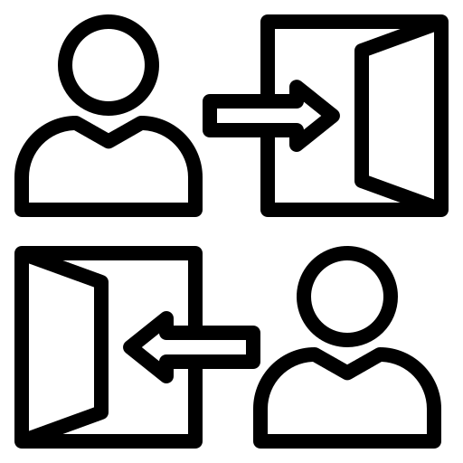
Access Control
#Security and Privacy threats in the Cloud
#Introduction on Cloud and Cloud Security
Different users enjoy different access privileges regarding the data
Lack of trusted server
Enforcing secure, efficient, and reliable data access among a large number of users is critical

Slide 14
Virtualization & Hypervisor
#Security and Privacy threats in the Cloud
#Introduction on Cloud and Cloud Security
Although these technologies provides a means to generate virtualized resources for sharing the underline physical resources, such technology’s also increases the attack surface.
Example of Attack: Virtualization Attack
As cloud providers grant cloud consumers access to virtualized IT resources, there is an inherent risk that cloud consumers may abuse this access to attack
underlying physical IT resource.

Slide 15

Overlapping Trust Boundaries
#Security and Privacy threats in the Cloud
#Introduction on Cloud and Cloud Security
If physical IT assets within a cloud are shared by multiple consumers of cloud services, we say these
consumers have overlapping boundaries of trust.
Malicious cloud consumers can target shared IT resources with the intention of compromising other consumers.

Slide 16


Privacy and Data Protection
#Security and Privacy threats in the Cloud
#Introduction on Cloud and Cloud Security
By migrating workloads to a shared infrastructure, customers’ confidential information faces increased risk of potential unauthorized access and exposure.
In a related issue, it’s becoming important to know who created a piece of data, who modified it and how, and so on.
Cloud service providers must assure their customers and provide a high degree of transparency into their operations and privacy assurance.
Provenance information could be used for various purposes such as traceback, auditing, and history-based access control

Slide 17
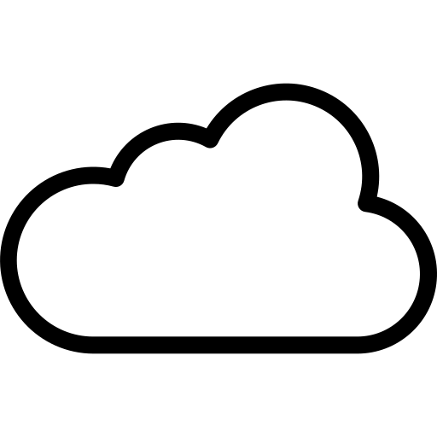

Security Policy Disparity
#Security and Privacy threats in the Cloud
#Introduction on Cloud and Cloud Security
When a cloud consumer entrusts IT resources to a public cloud provider, they may have to accept that their traditional approach to information security may not be identical or even similar to that of the cloud provider.
≠
User Security
Cloud Security

Slide 18
Countermeasures to Cloud Security Threats
03
#Countermeasures to Cloud Security Threats

Slide 19
BASE Mechanisms
#Countermeasures to Cloud Security Threats
Encryption
Hashing
It is used to encode plain text data in a secure format that is unreadable by unauthorized users.
Hashing can be used to derive a hashing code (or digest) from a message.
The sender of the message, then attaches the message digest to the original message.
Its goal is to preserve the confidentiality
of the data.
The recipient applies the same hash function to the message to verify that the digest produced is identical to the one that accompanied the message.
Encryption at Rest is particularly important in a Cloud environment.
Any modification to the original data results
in a completely different message digest and clearly indicates that a tamper has occurred.

Slide 20



ADVANCED Mechanisms
#Countermeasures to Cloud Security Threats
Digital Signature
Public Key Infrastructure (PKI)
Single Sign-On (SSO)
A message is digitally signed before transmission, which is then rendered invalid if the message undergoes subsequent unauthorized modification.
This mechanism allows cloud consumer to be authenticated by a security broker, which
establishes a security context that is maintained while the cloud consumer accesses other cloud services.
This system is used to bind public keys to their respective key owners while allowing verification of the validity of the key.

Slide 21
ADVANCED Mechanisms - Identity and Access Management (IAM)
#Countermeasures to Cloud Security Threats
This mechanism includes the components and policies needed to control and track user identities and access privileges for IT systems, environments, and resources.
Authentication
Authorization
IAM
User Management
Credential Management

Slide 22


CLOUD-SPECIFIC Mechanisms
#Countermeasures to Cloud Security Threats
Cloud-Based Security Groups
Hardened Virtual Server Images
Networks are segmented into security groups that form the logical network perimeters
Hardening virtual server image is the process of removing unnecessary software from a system to limit potential vulnerabilities that can be exploited by attackers
Each security group is assigned specific rules that govern communication between security groups
This results in a virtual server template that is significantly more secure than the original standard image.

Slide 23
Security services of the main Cloud Providers
04
#Security services of the main Cloud Providers

Slide 24
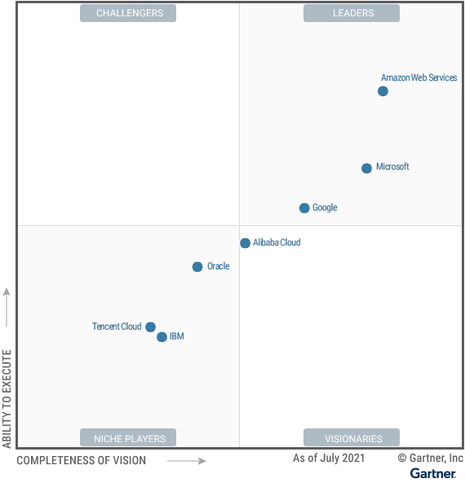
Usage statistics of the main Cloud Providers
#Security services of the main Cloud Providers
x
x

Slide 25

Overview of the security mechanisms adopted by AWS -01
#Security services of the main Cloud Providers
Infrastructure Protection
Data Protection
Detection
AWS Network Firewall
AWS Shield
Amazon Macie
AWS Certificate Manager
Amazon GuardDuty
Amazon Inspector

Slide 26
Overview of the security mechanisms adopted by AWS -02
#Security services of the main Cloud Providers
IAM
Incidence Response
Compliance
AWS IAM
Amazon Cognito
AWS Elastic Disaster Recovery (AWS DRS)
AWS Audit Manager

Slide 27

Overview of the security mechanisms adopted by Azure -01
#Security services of the main Cloud Providers
Operations
Applications
Storage
Microsoft Defender for Cloud
Application Insights
Penetration Testing
Web Application firewall
Azure role-based access control
Storage Service Encryption

Slide 28
Overview of the security mechanisms adopted by Azure -02
#Security services of the main Cloud Providers
Networking
Compute
IAM
VPN Gateway
Express Route
Virtual machine backup
Azure Site Recovery
Azure Active Directory

Slide 29
Analysis of a real case study: attack to Tesla
05
#Analysis of a real case study: attack to Tesla

Slide 30
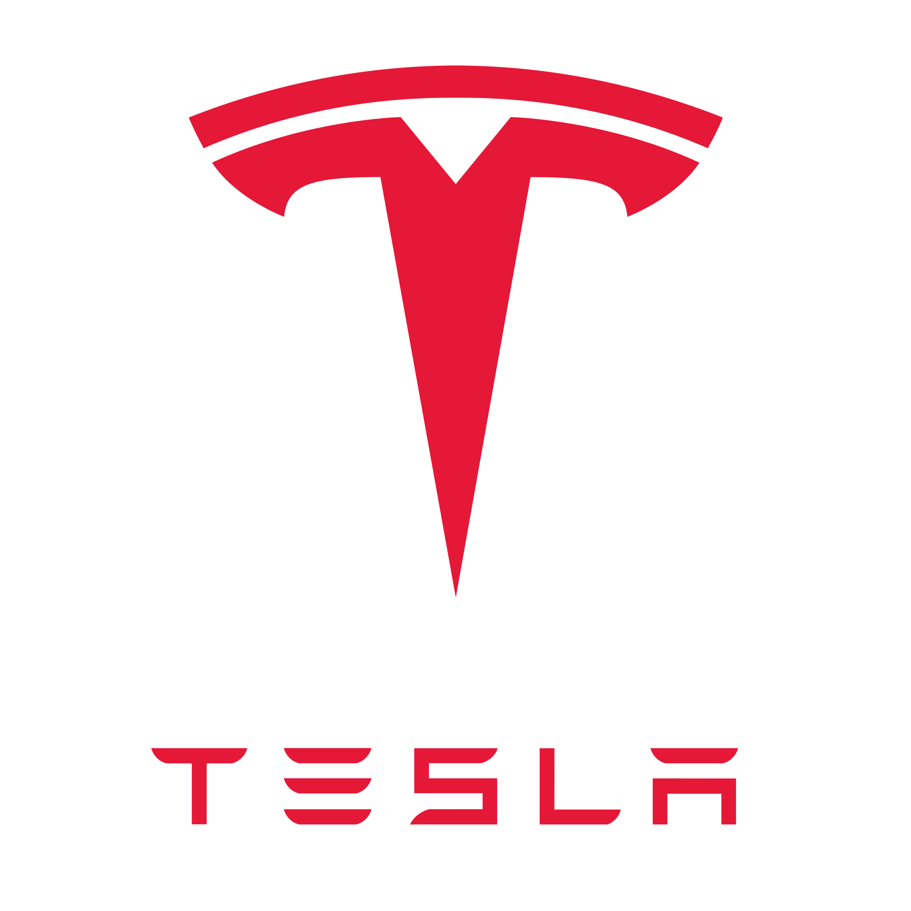
Attack Details
#Analysis of a real case study: attack to Tesla
Actor
External malicious hacker(s) gained access to an unsecured Kubernetes administrative interface.
Attack
Attack
Details
gained access to AWS access credentials via the unsecured Kubernetes interface
access to S3 buckets containing non-public vehicle telemetry data
attackers installed mining scripts
Vulnerabilities
Insufficient credential management and effective encryption
Inadequate antimalware and security monitoring failed to detect and prevent the installation of mining scripts.

Slide 31
Attack Impacts
#Analysis of a real case study: attack to Tesla
(technical & Business)

Slide 32
Attack Mitigation - Preventive
#Analysis of a real case study: attack to Tesla

Slide 33
Attack Mitigation - Detective
#Analysis of a real case study: attack to Tesla

Slide 34
Attack Mitigation - Corrective
#Analysis of a real case study: attack to Tesla

Slide 35
Blockchain and Cloud Security
06
#Blockchain and Cloud Security

Slide 36
What is blockchain technology?
#Blockchain and Cloud Security

Slide 37
Where blockchain technology comes handy?
#Blockchain and Cloud Security

Slide 38
Blockchain security and Cloud Computing
#Blockchain and Cloud Security

Slide 39
Blockchain-as-a-Service (BaaS)
#Blockchain and Cloud Security

Slide 40
Blockchain-enabled Data Provenance in Cloud
#Blockchain and Cloud Security

Slide 41
Blockchain-based Access Control in Cloud
#Blockchain and Cloud Security

Slide 42
Cloud Computation & Storage Offloading for Blockchain
#Blockchain and Cloud Security

Slide 43
Cloud Hardware for Blockchain mining
#Blockchain and Cloud Security

Slide 44
Doodle Clouds Infographics
Has a beautiful name and is the second planet from the Sun in the Solar System
Neptune is the farthest planet from the Sun. Is far away from Earth. It is colour blue
Despite being red, Mars is a cold place full of red dust. It was named after a God
Is the ringed one. It’s made of hydrogen and helium. It has several rings. It’s a gas giant

Slide 45
Definition of Cloud
#Introduction on Cloud and Cloud Security
Neptune
Mars
Is the farthest planet from the Sun. Is far away from Earth. It’s the fourth-largest
planet Mars is a very cold place full of red dust.It was named after a god
Saturn
Mercury
Saturn is the ringed one. It’s made of hydrogen and helium. It is the sixth planet
Is the closest planet to the Sun and the smallest one. It was named after a god

Slide 46
Doodle Clouds Infographics
08
01
Saturn is the ringed one. It’s mostly made of hydrogen and helium
01
Saturn is the ringed one. It’s mostly made of hydrogen and helium
08
02
07
02
Is the biggest object in the Solar System and also a gas giant
Is the biggest object in the Solar System and also a gas giant
07
Mercury
03
06
03
Neptune is the farthest planet from the Sun. Is very far away from Earth
Neptune is the farthest planet from the Sun. Is very far away from Earth
06
04
05
04
Is the biggest object in the Solar System and also a gas giant
Is the biggest object in the Solar System and also a gas giant
05

Slide 47
Doodle Clouds Infographics
Neptune
Mars
Is the farthest planet from the Sun. Is far away from Earth. It’s the fourth-largest
planet Mars is a very cold place full of red dust.It was named after a god
Saturn
Mercury
Saturn is the ringed one. It’s made of hydrogen and helium. It is the sixth planet
Is the closest planet to the Sun and the smallest one. It was named after a god

Slide 48
Doodle Clouds Infographics
Mercury
Neptune
Mercury is the closest planet to the Sun
Neptune is the farthest planet from the Sun
Jupiter
Mars
Saturn
planet Mars is a very cold place full of red dust
Planet Saturn is made of hydrogen and helium

Slide 49
Doodle Clouds Infographics
Jupiter
Venus
Is the biggest object in our Solar System and also a gas giant. It has many satellites
Has a beautiful name and is the second planet from the Sun in the Solar System
Mercury
Neptune
Is the closest planet to the Sun and the smallest one. It was named after a Roman
Neptune is the farthest planet from the Sun. Is far away from Earth.It is color blue

Slide 50
Doodle Clouds Infographics
Jupiter is the biggest object in our Solar System
Neptune is the farthest planet from the Sun
Jupiter
Is the closest planet to the Sun and the smallest
Planet Saturn is made of hydrogen and helium
Has a nice name and is the second planet from the Sun
Despite being red, planet Mars is a very cold place

Slide 51
Doodle Clouds Infographics
Is the biggest object in our Solar System and also a gas giant
Is the farthest planet from the Sun. Is far away from Earth
Mercury is the closest planet and the smallest one
Is the ringed one. It’s made of hydrogen and helium
Jupiter
Has a nice name and is the second planet from the Sun
Despite being red, Mars is a very cold place full of red dust

Slide 52
Doodle Clouds Infographics
Is the biggest object in our Solar System and also a gas giant
Is the farthest planet from the Sun. Is far away from Earth
Mercury is the closest planet and the smallest one
Is the ringed one. It’s made of hydrogen and helium
Jupiter
Has a nice name and is the second planet from the Sun
Despite being red, Mars is a very cold place full of red dust

Slide 53
Doodle Clouds Infographics
Jupiter
Venus
Neptune
Venus has a beautiful name and is the second planet
Is the farthest planet from the Sun. Is far away from Earth
Mercury
Mars
Saturn
Mercury is the closest planet to the Sun and the smallest one
Despite being red, planet is a very cold place full of red dust
It’s made of hydrogen and helium. It has several rings

Slide 54
Doodle Clouds Infographics
Neptune
Is the farthest planet from the Sun. Is far away from Earth.It is colour blue
Saturn
Is the ringed one. It’s made of hydrogen and helium. It has several rings. It’s a gas giant
Mars
Mercury
Is the closest planet to the Sun and the smallest one. It was named after a Roman
Mars
Despite being red, planet Mars is a very cold place full of red dust

Slide 55
Doodle Clouds Infographics
Venus
Neptune
Venus has a beautiful name and is the second planet from the Sun
Is the farthest planet from the Sun. Is far away from Earth.It is color blue
Mars
Mercury
Saturn
Mercury is the closest planet to the Sun and the smallest one
It’s made of hydrogen and helium. It has several rings. It’s a gas giant

Slide 56
Doodle Clouds Infographics
Neptune
Saturn
Neptune is the farthest planet from the Sun. Is far away from Earth
Saturn made of hydrogen and helium. It has several rings
Mars
Despite being red, planet is a very cold place full of red dust
Jupiter
Mercury
Is the biggest object in our Solar System and also a gas giant
Mercury is the closest planet to the Sun and the smallest one

Slide 57
Doodle Clouds Infographics
Mars
Mercury
Despite being red, planet Mars is a very cold place full of red dust
Mercury is the closest planet to the Sun and the smallest one
Venus
Venus has a beautiful name and is the second planet to Sun
Neptune
Saturn
Is the farthest planet from the Sun. Is far away from Earth
Saturn made of hydrogen and helium. It has several rings

Slide 58
Doodle Clouds Infographics
01
02
03
04
Mercury is the closest planet to the Sun and the smallest one
Despite being red, planet Mars is a very cold place full of red dust
Is the farthest planet from the Sun. Is far away from Earth
It’s made of hydrogen and helium. It is the sixth planet

Slide 59
Doodle Clouds Infographics
Mars
Venus
Neptune
Saturn
Is the biggest object in our Solar System and also a gas giant. It has many satellites
Has a beautiful name and is the second planet from the Sun in the Solar System
Is the farthest planet from the Sun. Is far away from Earth.It is colour blue
Saturn is the ringed one. It’s made of hydrogen and helium. It has several rings

Slide 60
Doodle Clouds Infographics
Venus
Jupiter
Has a beautiful name and is the second planet from the Sun
Is the biggest object in our Solar System and also a gas giant
Saturn
Mercury
Saturn is the ringed one. It’s made of hydrogen and helium
Mercury is the closest planet to the Sun and the smallest one

Slide 61
Doodle Clouds Infographics
01
02
03
04
05
Mercury is the smallest and the closest planet to the Sun
Has a beautiful name and is the second planet from the Sun
It’s the farthest planet from the Sun. Is far away from Earth
Despite being red, Mars is actually a very cold place
Is the biggest object in the Solar System and also a gas giant

Slide 62
Doodle Clouds Infographics
A
Is the ringed one. It’s made of hydrogen and helium. It has several rings
A
B
Is the farthest planet from the Sun. Is far away from Earth.It is colour blue
D
B
C
Has a beautiful name and is the second planet from the Sun in the Solar System
D
Is the closest planet to the Sun and the smallest one. It was named after a Roman
C

Slide 63
Doodle Clouds Infographics
Neptune
Jupiter
Is the farthest planet from the Sun. Is far away from Earth
Is the biggest object in our Solar System and also a gas giant
Saturn
Mercury
Is the ringed one. It’s made of hydrogen and helium
Mars
Is the closest planet to the Sun and the smallest one
Mars
Venus
Despite being red, Mars is a very cold place full of red dust
Has a beautiful name and is the second planet from the Sun

Slide 64
Doodle Clouds Infographics
Jupiter
1
Is the biggest object in our Solar System and also a gas giant
Mercury
2
Is the closest planet to the Sun and the smallest one
Venus
3
Has a beautiful name and is the second planet from the Sun
Mars
4
Despite being red, Mars is a very cold place full of red dust

Slide 65
Doodle Clouds Infographics
85%
Is the biggest object in our Solar System and also a gas giant
62%
Is the closest planet to the Sun and the smallest one
50%
Has a beautiful name and is the second planet from the Sun
10%
Despite being red, Mars is a very cold place full of red dust
10%
50%
62%
85%

Slide 66
Doodle Clouds Infographics
25%
10%
60%
95%
Neptune
Venus
Mars
Jupiter
Is the farthest planet from the Sun. Is far away from Earth
Has a beautiful name and is the second planet from the Sun
Despite being red, Mars is a very cold place full of red dust
Is the biggest object in the Solar System and also a gas giant

Slide 67
Doodle Clouds Infographics
Is the biggest object in our Solar System and also a gas giant
Has a beautiful name and is the second planet from the Sun
Jupiter
Venus
Despite being red, Mars is a very cold place full of red dust
Mars
Neptune
Saturn is the ringed one. It’s made of hydrogen and helium
Saturn
Is the closest planet to the Sun and the smallest one
Mercury

Slide 68
Doodle Clouds Infographics
Neptune
Jupiter
Is the farthest planet from the Sun. Is far away from Earth
Is the biggest object in our Solar System and also a gas giant
Saturn
Mercury
Saturn is the ringed one. It’s made of hydrogen and helium
Jupiter
Is the closest planet to the Sun and the smallest one
Mars
Venus
Despite being red, Mars is a very cold place full of red dust
Has a beautiful name and is the second planet from the Sun

Slide 69
Doodle Clouds Infographics
Jupiter
Mercury
Mars
Neptune
Saturn
Mercury is the closest planet to the Sun
planet Mars is a very cold place full of red dust
Neptune is the farthest planet from the Sun
Planet Saturn is made of hydrogen and helium

Slide 70
Doodle Clouds Infographics
Venus
Neptune
Has a beautiful name and is the second planet from the Sun in the Solar System
Is the farthest planet from the Sun. Is far away from Earth.It is color blue

Slide 71
Doodle Clouds Infographics
Jupiter
Venus
Is the biggest object in our Solar System and also a gas giant
Mercury
Has a beautiful name and is the second planet from the Sun
Is the closest planet to the Sun and the smallest one

Slide 72
Doodle Clouds Infographics
Neptune
Jupiter
Is the farthest planet from the Sun. Is far away from Earth
Is the biggest object in our Solar System and also a gas giant
Saturn
Mercury
Saturn is the ringed one. It’s made of hydrogen and helium
Is the closest planet to the Sun and the smallest one
Mars
Venus
Despite being red, Mars is a very cold place full of red dust
Has a beautiful name and is the second planet from the Sun

Slide 73
Doodle Clouds Infographics
Saturn
Is the ringed one. It’s made of hydrogen and helium. It has several rings. It’s a gas giant
Jupiter
Is the biggest object in our Solar System and also a gas giant. It has many satellites
Venus
Has a beautiful name and is the second planet from the Sun in the Solar System

Slide 74
Instructions for use (free users)
In order to use this template, you must credit Slidesgo by keeping the Thanks slide.
You are allowed to:
Modify this template.
Use it for both personal and commercial purposes.
You are not allowed to:
Sublicense, sell or rent any of Slidesgo Content (or a modified version of Slidesgo Content).
Distribute this Slidesgo Template (or a modified version of this Slidesgo Template) or include it in a database or in any other product or service that offers downloadable images, icons or presentations that may be subject to distribution or resale.
Use any of the elements that are part of this Slidesgo Template in an isolated and separated way from this Template.
Delete the “Thanks” or “Credits” slide.
Register any of the elements that are part of this template as a trademark or logo, or register it as a work in an intellectual property registry or similar.
For more information about editing slides, please read our FAQs or visit Slidesgo School:
https://slidesgo.com/faqs and https://slidesgo.com/slidesgo-school

Slide 75
Instructions for use (premium users)
In order to use this template, you must be a Premium user on Slidesgo.
You are allowed to:
Modify this template.
Use it for both personal and commercial purposes.
Hide or delete the “Thanks” slide and the mention to Slidesgo in the credits.
Share this template in an editable format with people who are not part of your team.
You are not allowed to:
Sublicense, sell or rent this Slidesgo Template (or a modified version of this Slidesgo Template).
Distribute this Slidesgo Template (or a modified version of this Slidesgo Template) or include it in a database or in any other product or service that offers downloadable images, icons or presentations that may be subject to distribution or resale.
Use any of the elements that are part of this Slidesgo Template in an isolated and separated way from this Template.
Register any of the elements that are part of this template as a trademark or logo, or register it as a work in an intellectual property registry or similar.
For more information about editing slides, please read our FAQs or visit Slidesgo School:
https://slidesgo.com/faqs and https://slidesgo.com/slidesgo-school

Slide 76
Infographics
You can add and edit some infographics to your presentation to present your data in a visual way.
Choose your favourite infographic and insert it in your presentation using Ctrl C + Ctrl V or Cmd C + Cmd V in Mac.
Select one of the parts and ungroup it by right-clicking and choosing “Ungroup”.
Change the color by clicking on the paint bucket.
Then resize the element by clicking and dragging one of the square-shaped points of its bounding box (the cursor should look like a double-headed arrow). Remember to hold Shift while dragging to keep the proportions.
Group the elements again by selecting them, right-clicking and choosing “Group”.
Repeat the steps above with the other parts and when you’re done editing, copy the end result and paste it into your presentation.
Remember to choose the “Keep source formatting” option so that it keeps the design. For more info, please visit Slidesgo School.

